Slide 1
3D OBJECT RECONSTRUCTION USING SURFACE RENDERING
GROUP NO 16
SATYA KAUL
SINKESH JAIN
SURAJ POOJARY
­­
GUIDE: (PROF.) MS. RUPALI PATIL

Slide 2
INTRODUCTION
To generate a computer aided 3D model of a real-world object.
To reconstruct the 3D replica of the scanned object using Ball Pivoting Algorithm for surface reconstruction.
Ensuring linear time complexity and robustness on real scanned data.
Maintaining efficient usage of time and memory and to ensure numerical stability.
Focus on shape and geometry of object.
3D replica as the output for simple objects without sudden surface changes.

Slide 3
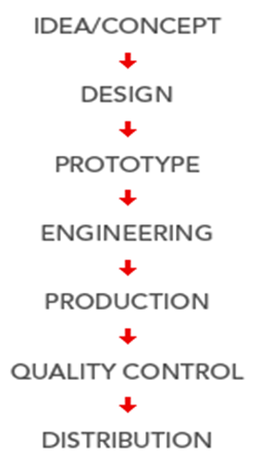
APPLICATIONS
Who can benefit from 3D Scanner?
General applications include
3D Representation / 3D Digitizing
Virtual Reality
Simulation
Reverse engineering
Quality Control
Medical CAD/CAM
Entertainment

Slide 4
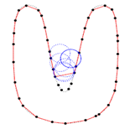
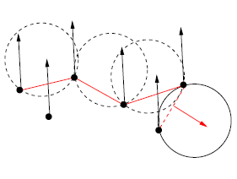
PROPOSED SYSTEM
BPA (BALL PIVOTING ALGORITHM)
Working
Follows the advancing-front paradigm.
Inputs: Surface-sample data points σ _{i} and a ball radius ρ.
Initially finds a seed triangle (i.e., three data points (σ _{i}, σ _{j}, σ _{k}) ), and adds one triangle at a time by performing the ball pivoting operation.
Algorithm is applied pass by pass using different radii.
All functions execute in linear time.

Slide 5
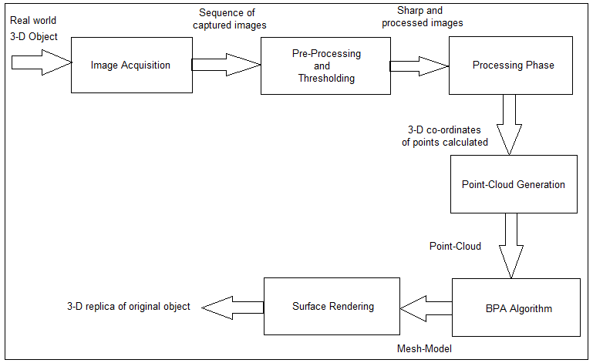
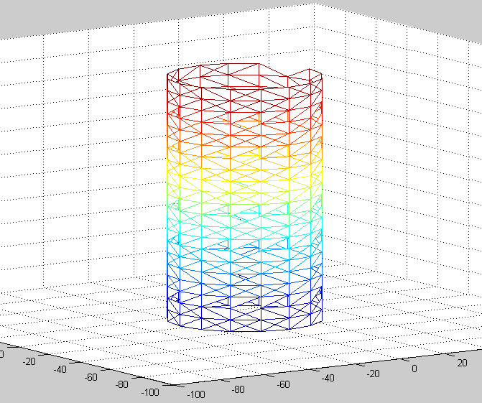
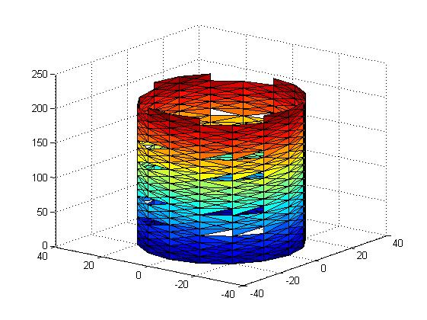
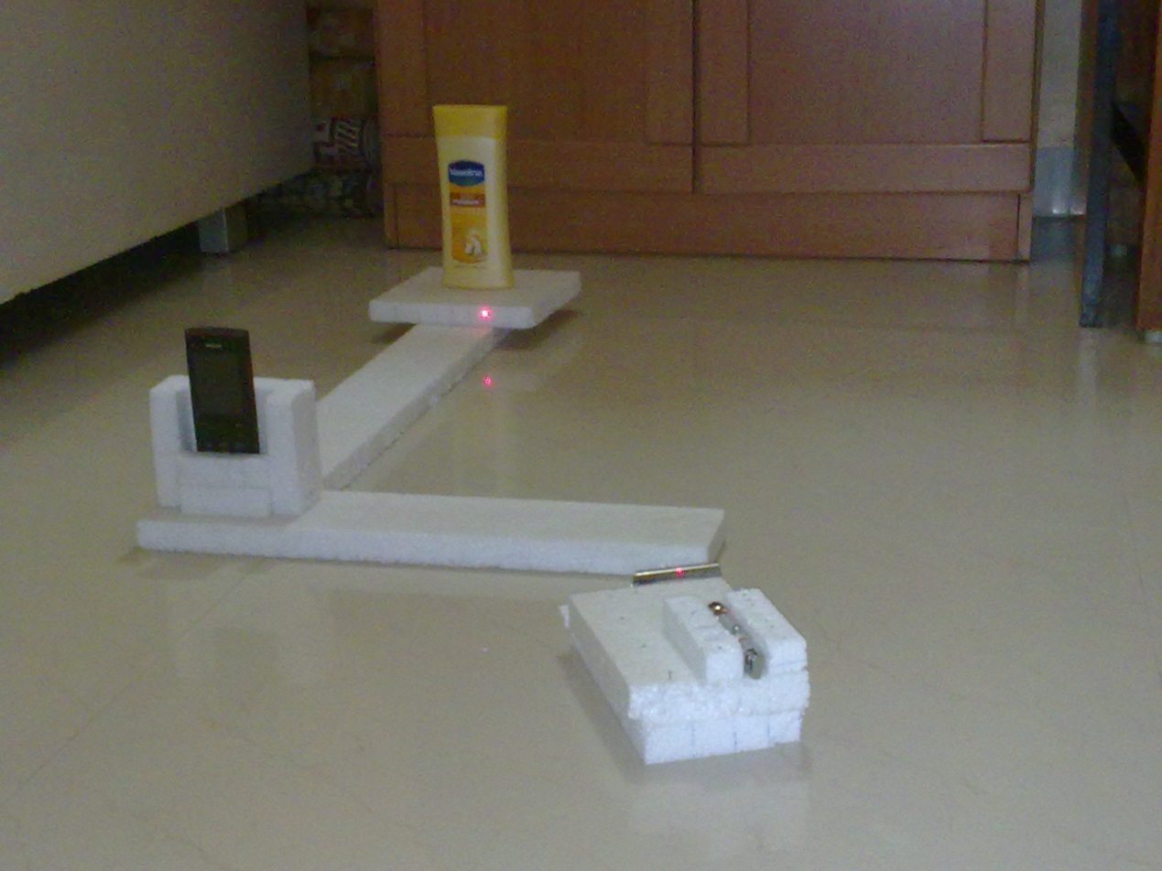
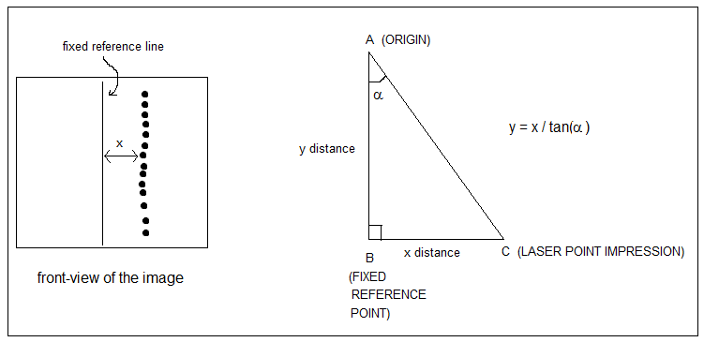
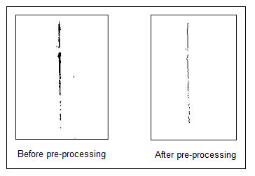
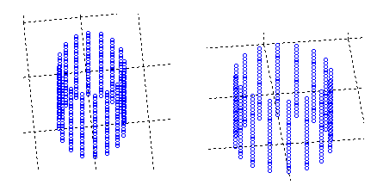
DESIGN
DESIGN DETAILS

Slide 6
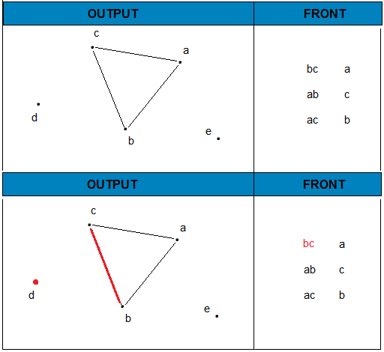
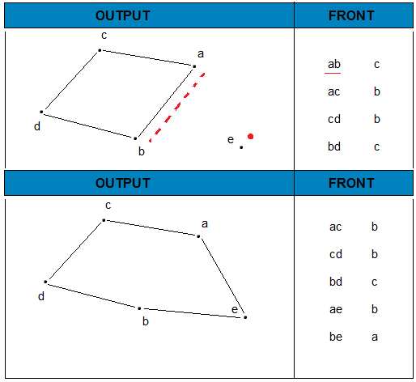
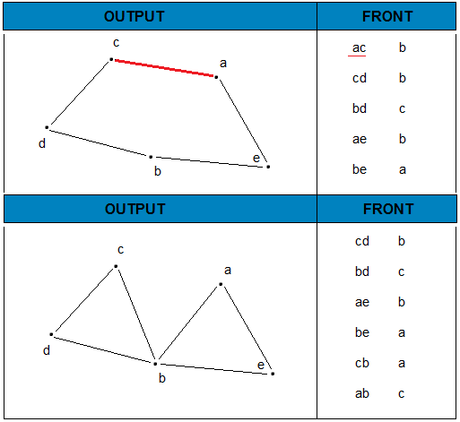
BALL PIVOTING ALGORITHM
Algorithm BPA(S,r)
while (true)
while ( e(i,j)) = get active edge(F))
if (ak = ball pivot( e(i,j) ) &&
(not used(ak ) || on front( ak)))
output triangle (ai , aj , ak)
join ( e( i ,j ), ak , F )
if (e( k , i) belongs to F)
glue(e(i , k), e(k , i), F)
if (e(j , k) belongs to F)
glue(e(k , j), e(j , k), F)
else
mark as boundary(e(i , j))
if ( ( ai, aj, ak) = find seed triangle())
output triangle( ai, aj, ak)
insert edge(e(i , j), F)
insert edge(e( j , k), F)
insert edge(e( k , i), F)
else
return

Slide 7
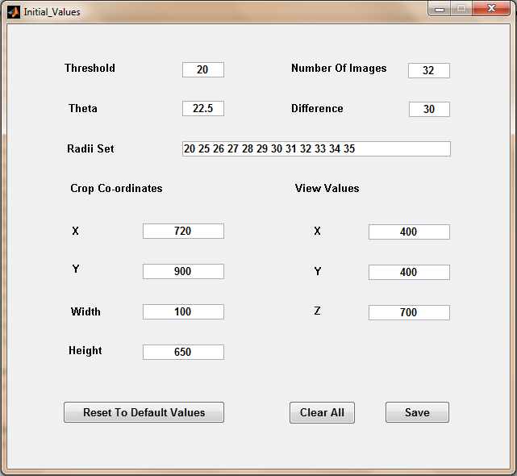
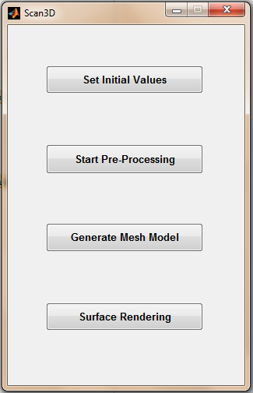
GUI DESIGN

Slide 8
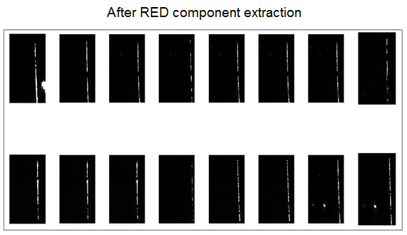
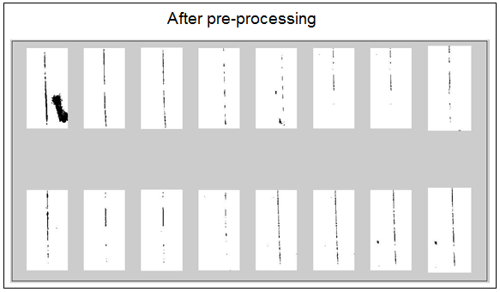
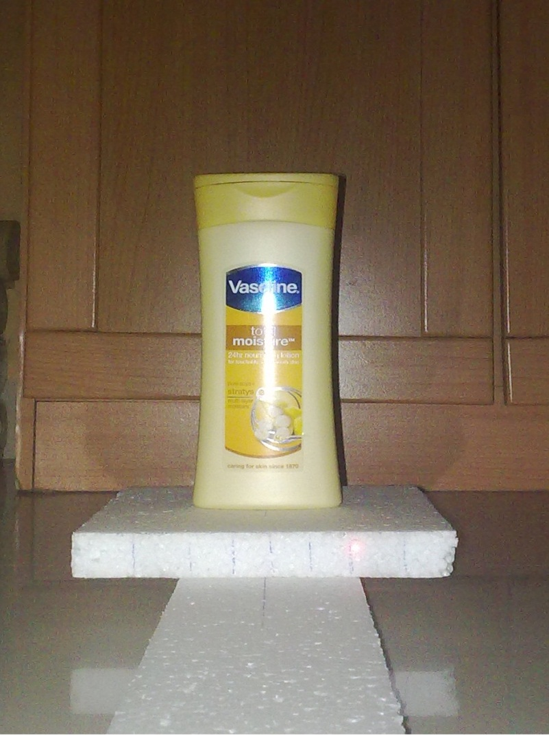
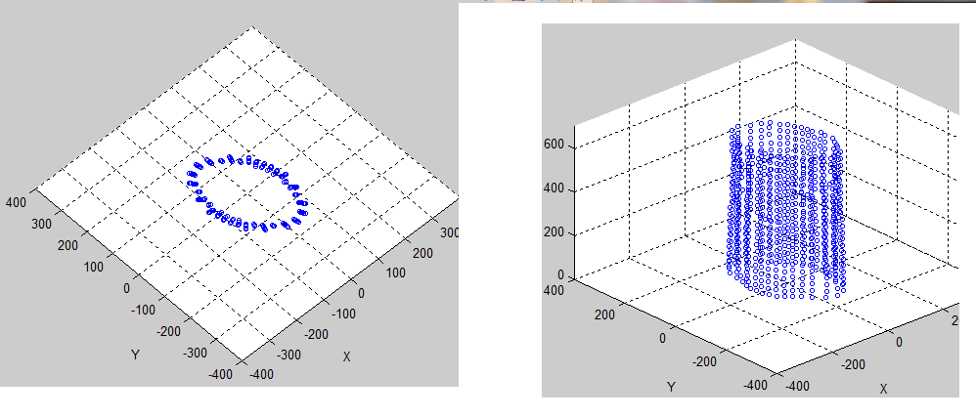
RESULTS

Slide 9
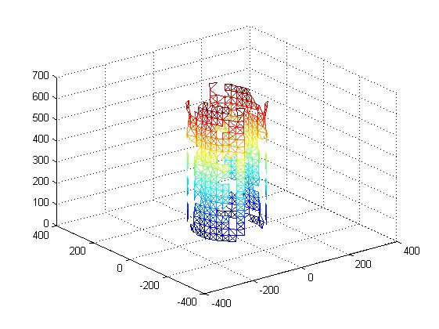
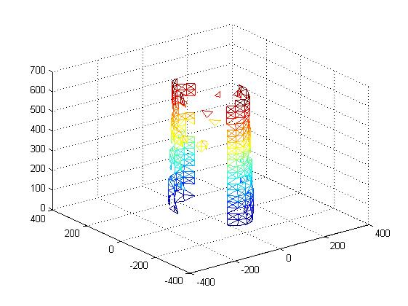
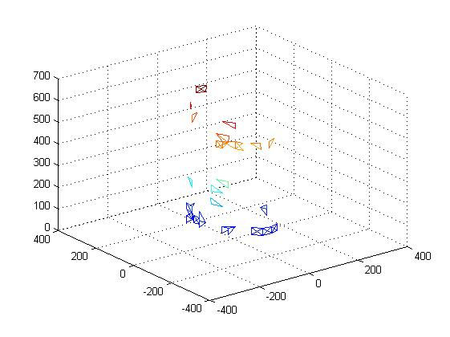
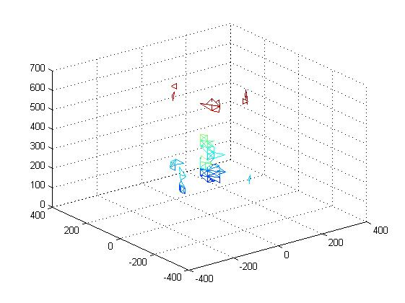
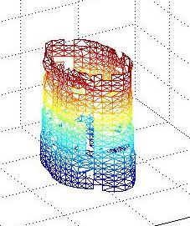
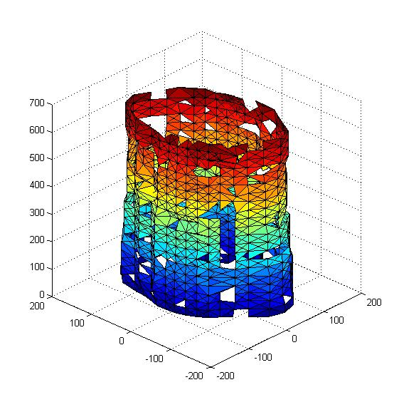
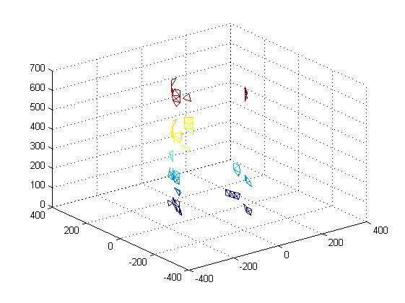
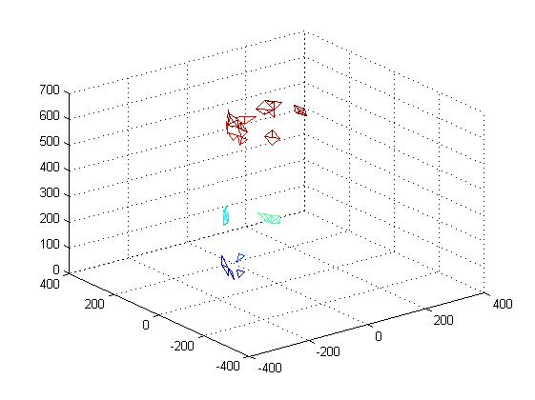
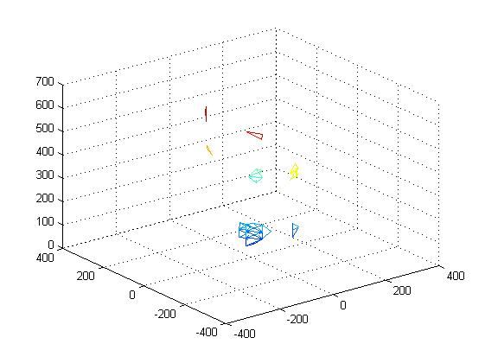
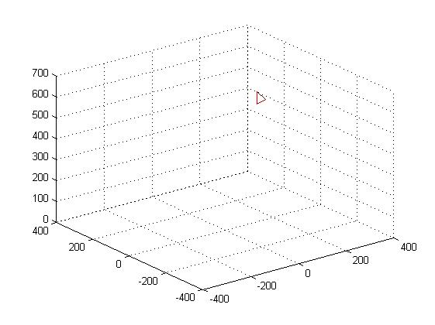
RESULTS (contd)

Slide 10
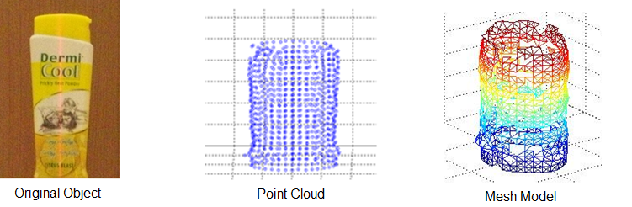
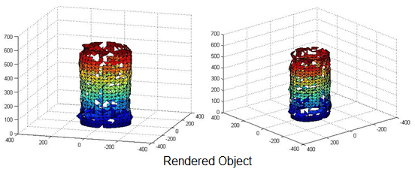
RESULTS (contd)

Slide 11
THANK YOU
Satya Kaul
Sinkesh Jain
Suraj Poojary

